Slide 1
ANCIENT GREEKS – YOUNG HEROES LESSON 1

Slide 2
The Ancient Greeks…
Who were the Ancient Greeks?
Where and when did the Ancient Greeks live?
The ancient Greek alphabet and language

Slide 3
What do you know about the Ancient Greeks?

Slide 4
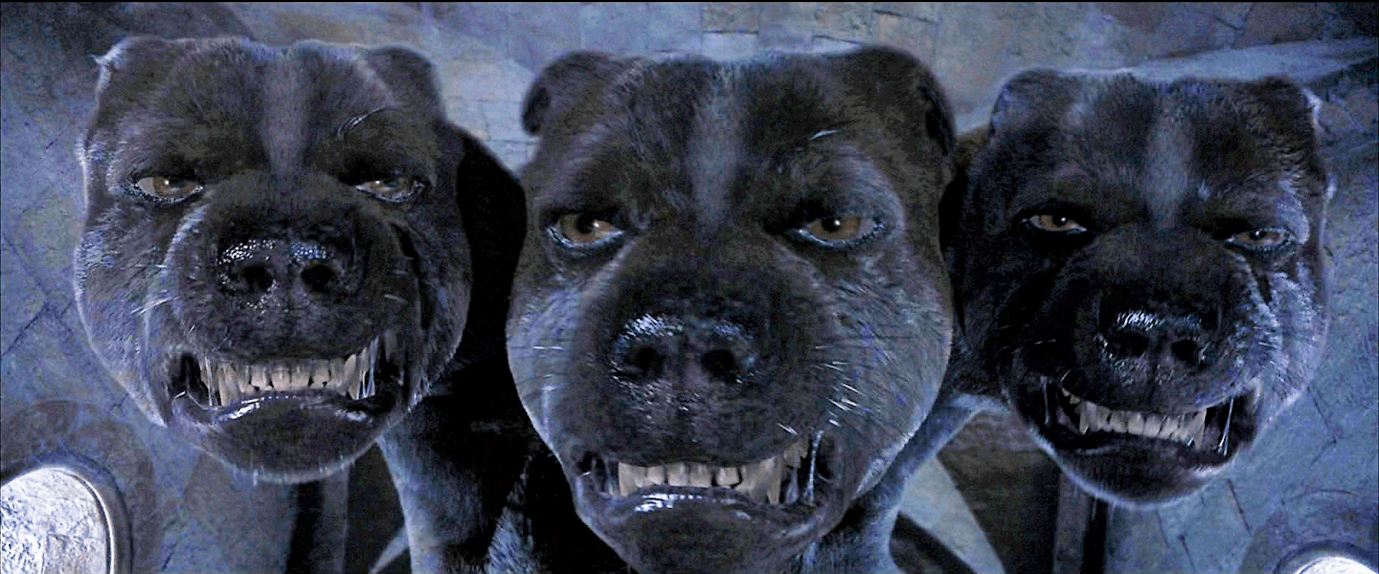
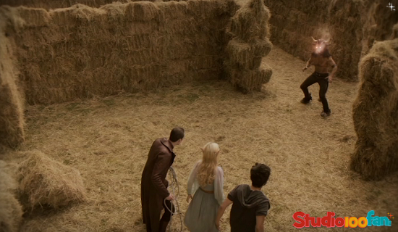
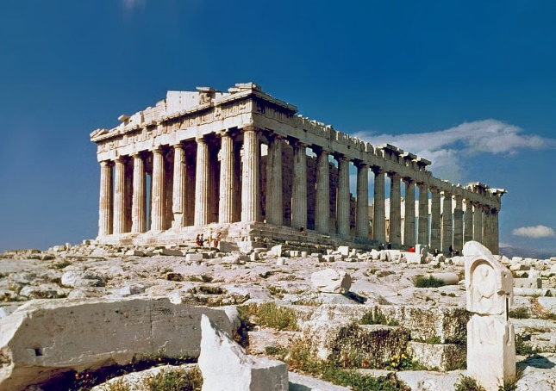
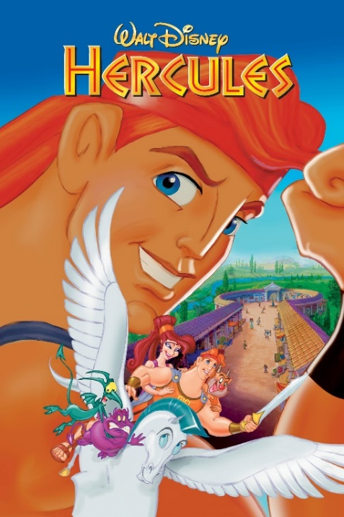
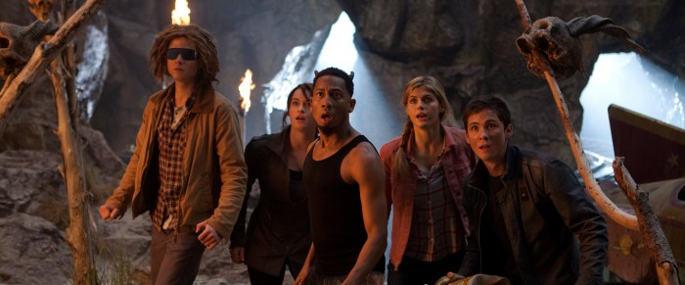
Influence of the Ancient Greeks

Slide 5
Where did the Ancient Greeks live?

Slide 6
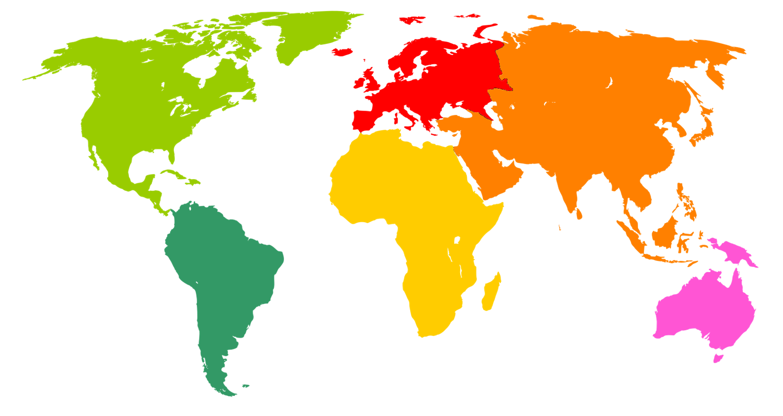

Slide 7
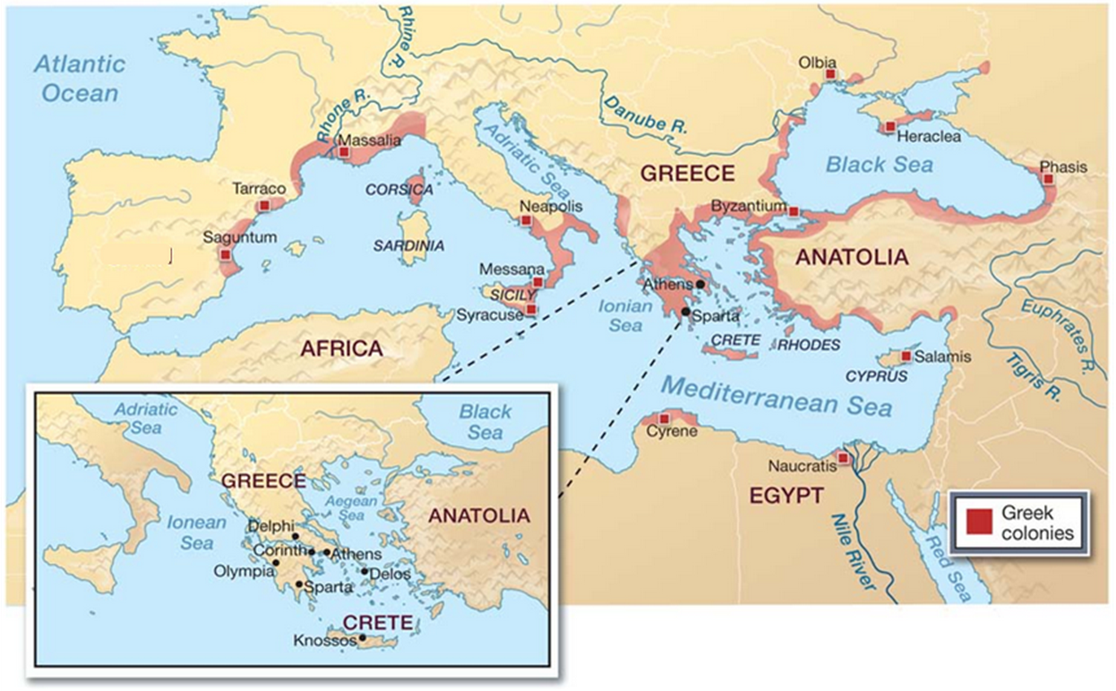
Where did the Ancient Greeks live?

Slide 8
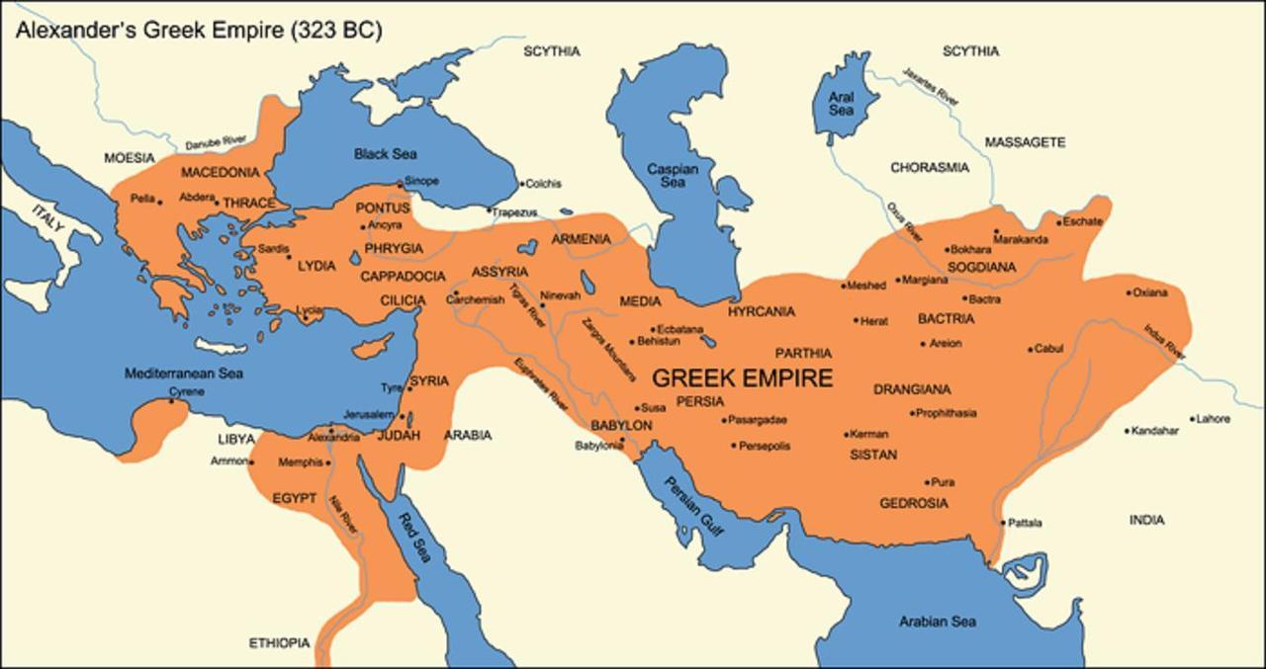
Where did the Ancient Greeks live?

Slide 9
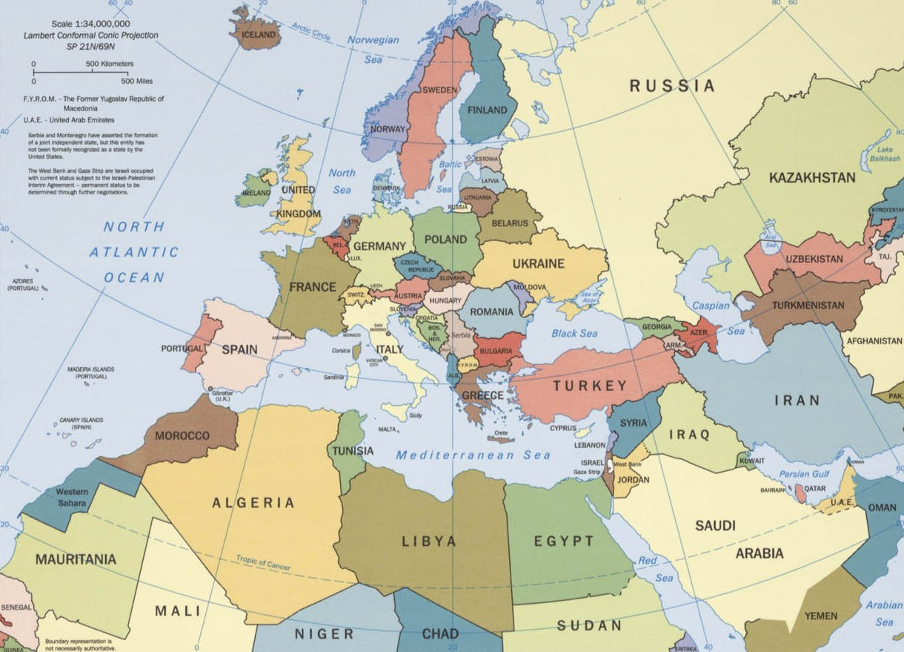
Where did the Ancient Greeks live?

Slide 10
When did the Ancient Greeks live?

Slide 11
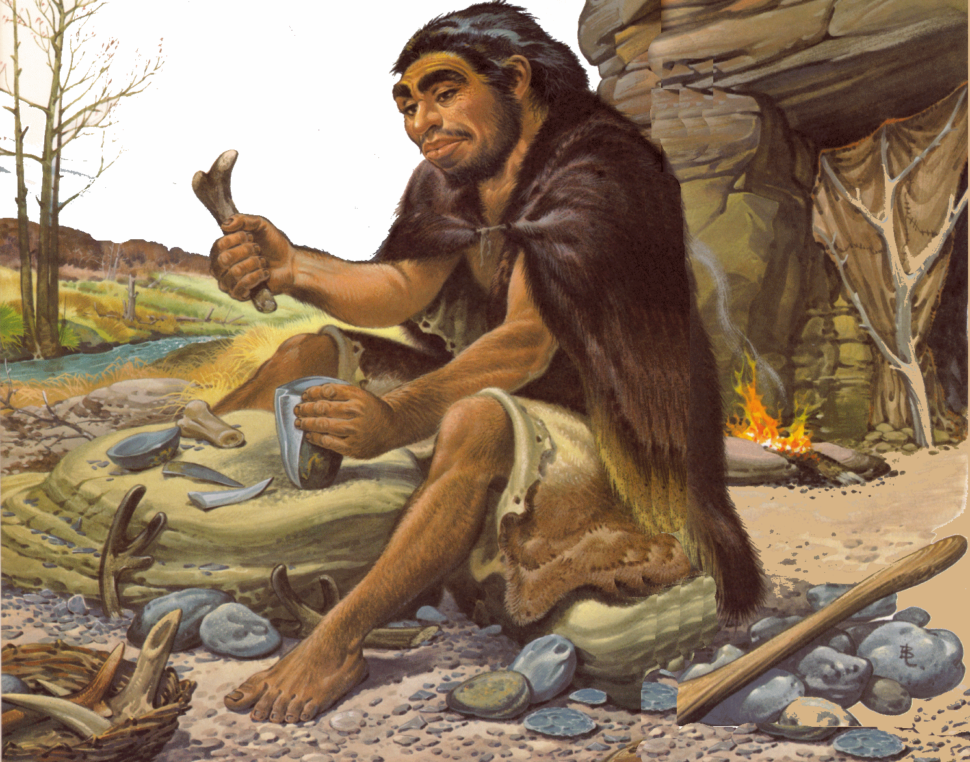
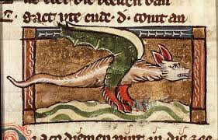
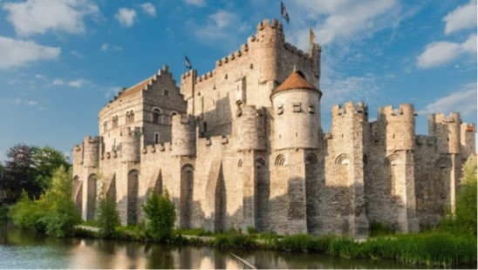
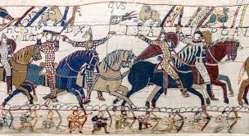
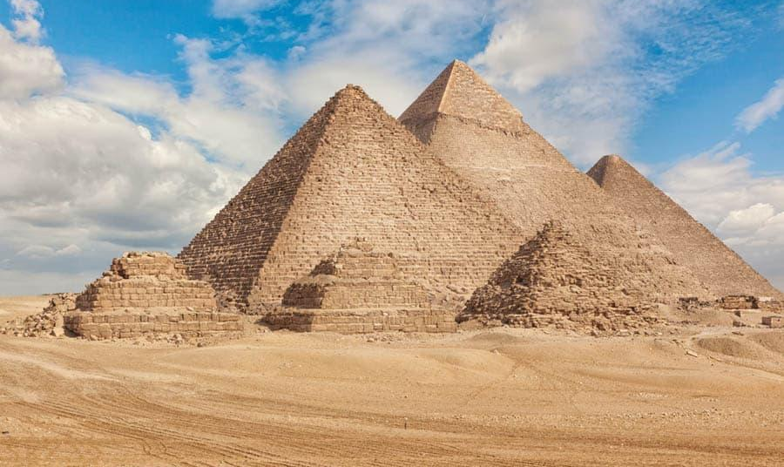
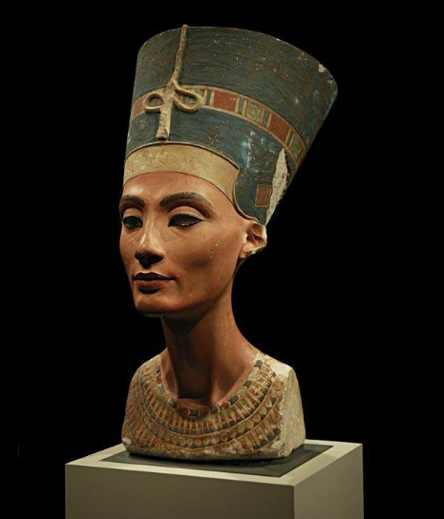
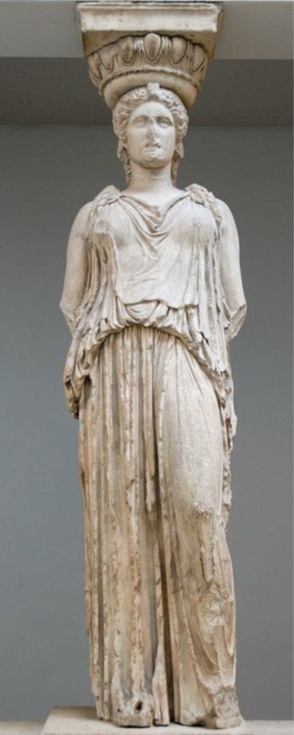
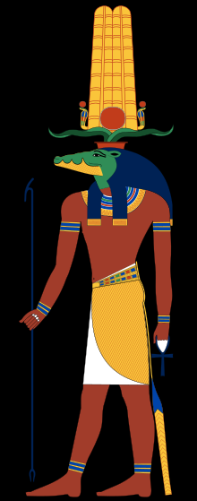
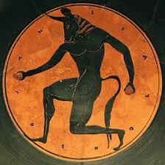
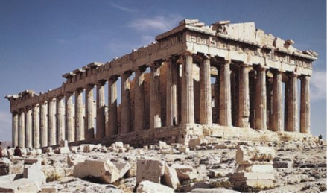
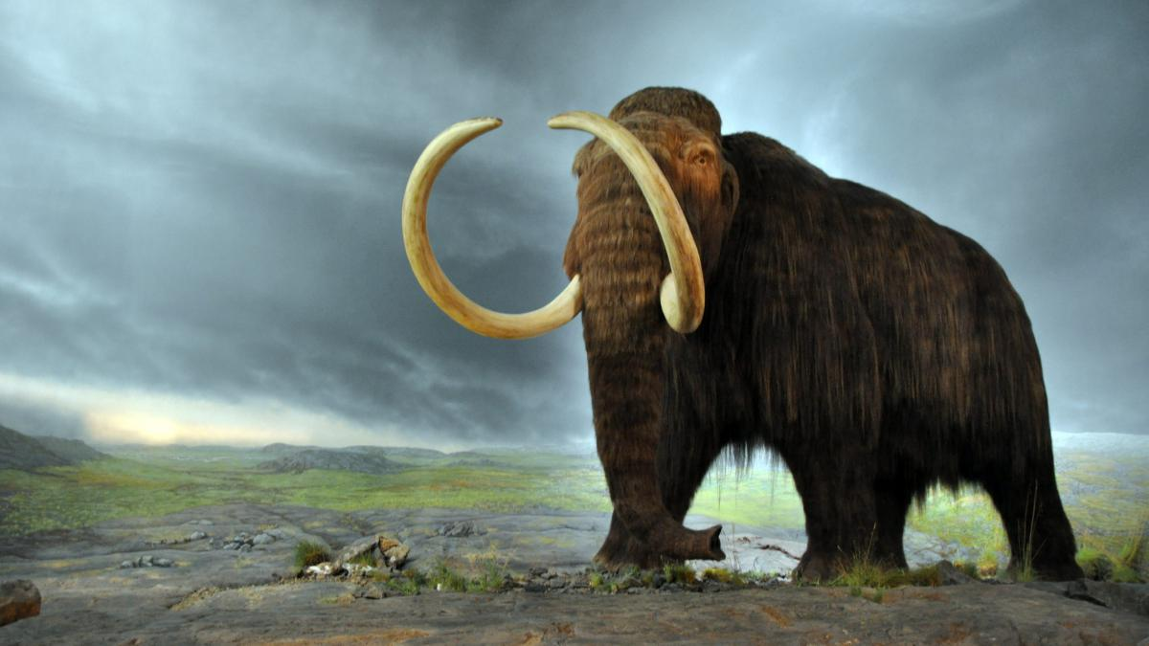
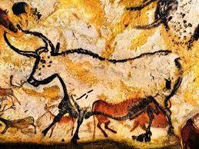
1
Timeline
3
2
4
5
7
6
8
9
10
8
12
11

Slide 12
When did the Ancient Greeks live?
ca. 1850
1945
ca. 3500 BC
ca. 800 BC
ca. 600 AD
1450
Modern Times
Prehistory
Ancient Near East
Classic Antiquity
Middle Ages
The New Era
The Newest Era

Slide 13
What language did the Ancient Greeks speak?

Slide 14
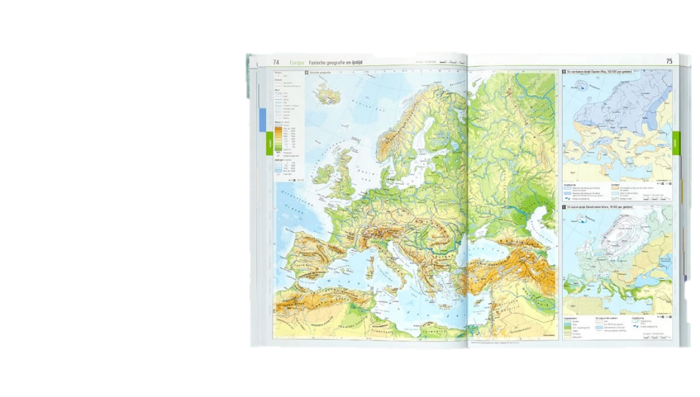
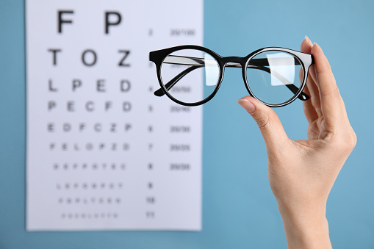
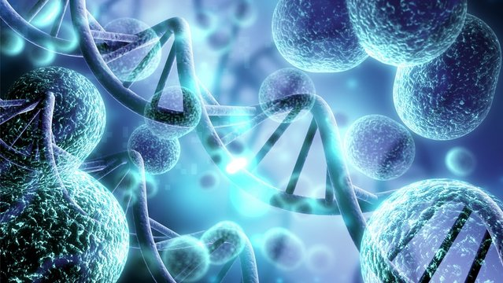
You already know ancient Greek!
ἀτλας
αὐτο
βιος
ὀπτικος

Slide 15
What language did the Ancient Greeks speak?
α β δ ε ι κ λ ο ς τ υ

Slide 16
The alphabet of the Ancient Greeks
Alpha-bet
αλφα - βητα

Slide 17
The alphabet of the Ancient Greeks
Alphabet
Bingo!

Slide 18
The alphabet of the Ancient Greeks
At the beginning of a word:
No h: ἀννα
With an h: ἁννα

Slide 19
The alphabet of the Ancient Greeks
Εὐρωπη
σχολη
ἀτομος
βαρβαρος
κυκλος
ὀργανον
πολιτικον
ζωιον

Slide 20
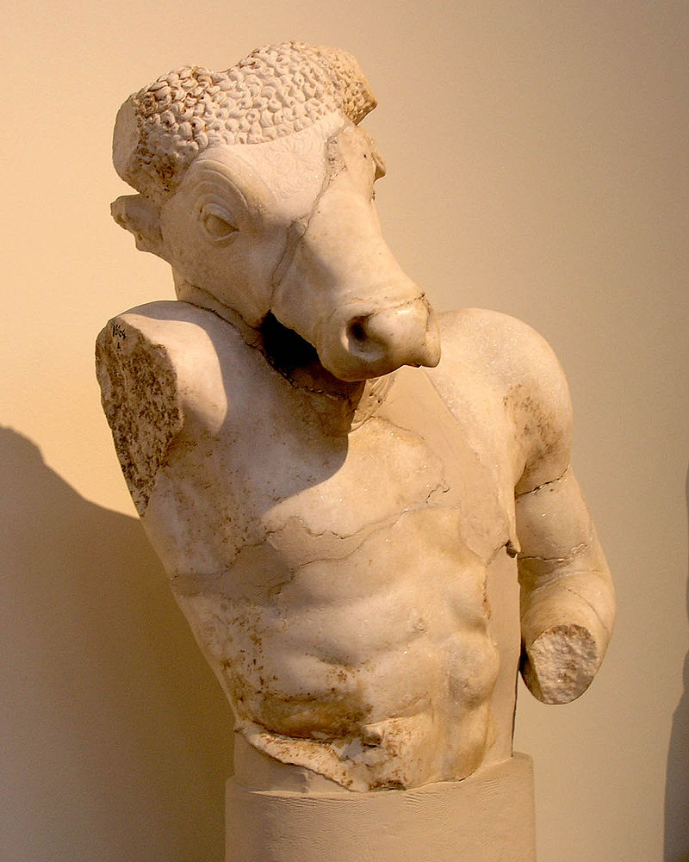
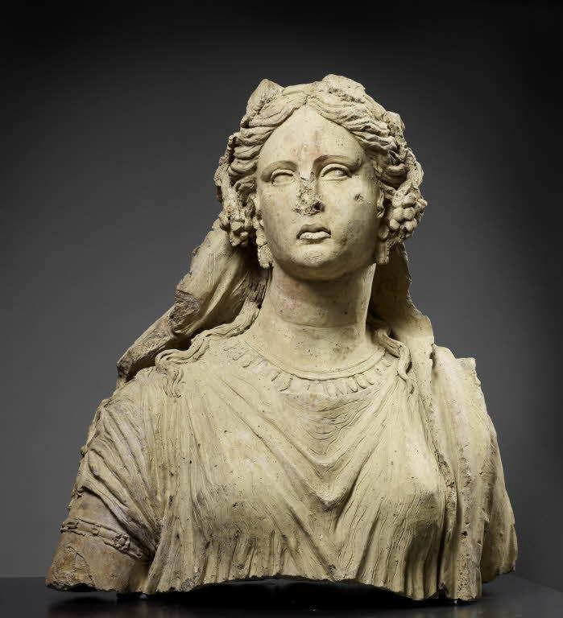
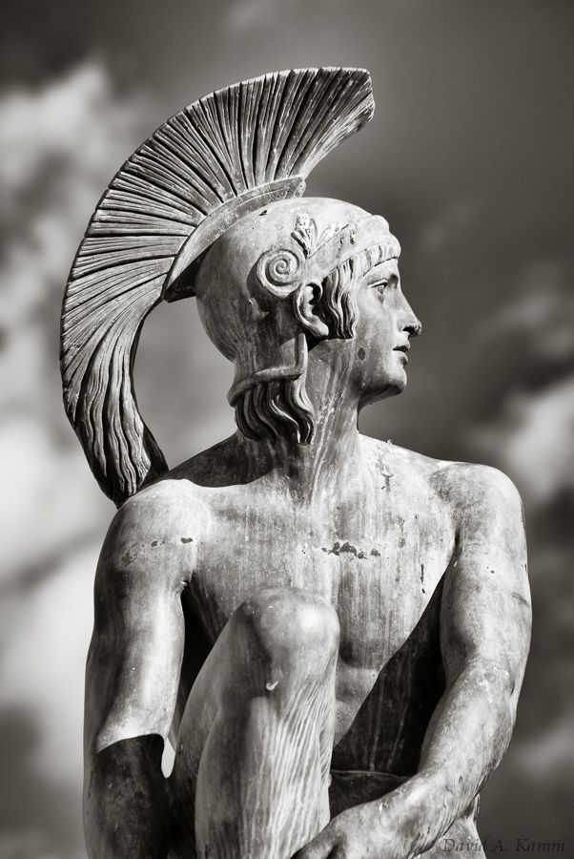
Νames in Ancient Greek
Μινωταυρος
Ἀριαδνη
Παιδιον

Slide 21
My name in Ancient Greek
Your name + η, ος or ον
Παυλ-ος
Ἑλεν-η
Παιδι-ον

Slide 22
Create your own monster

Slide 23
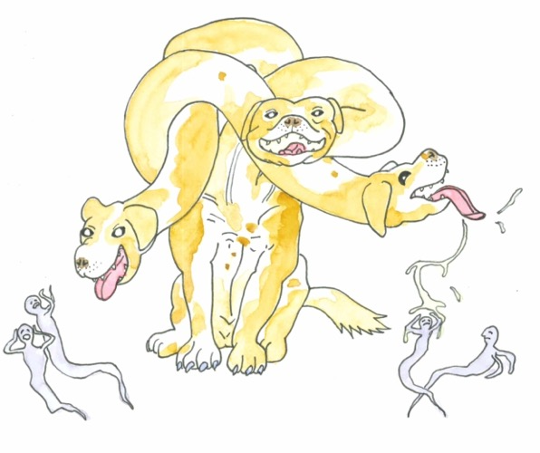
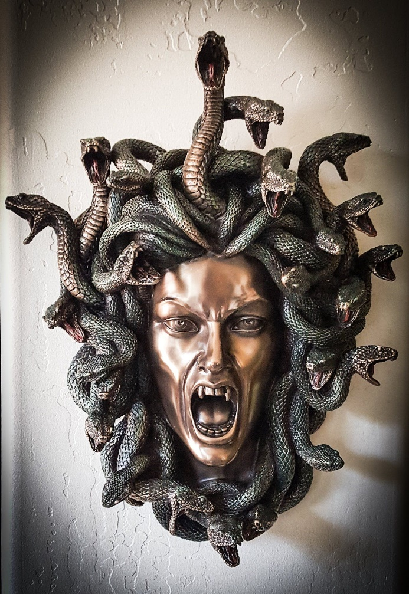
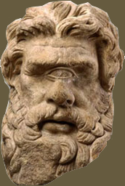
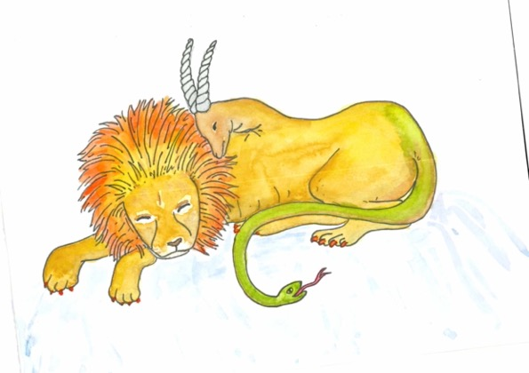
Making a monster head

Slide 24
What did we learn today?
Who came first: the medieval knights or the Ancient Greeks?
The Ancient Greeks
What does the word βιος mean?
Life
How do you pronounce this letter: λ?
L

