Slide 1
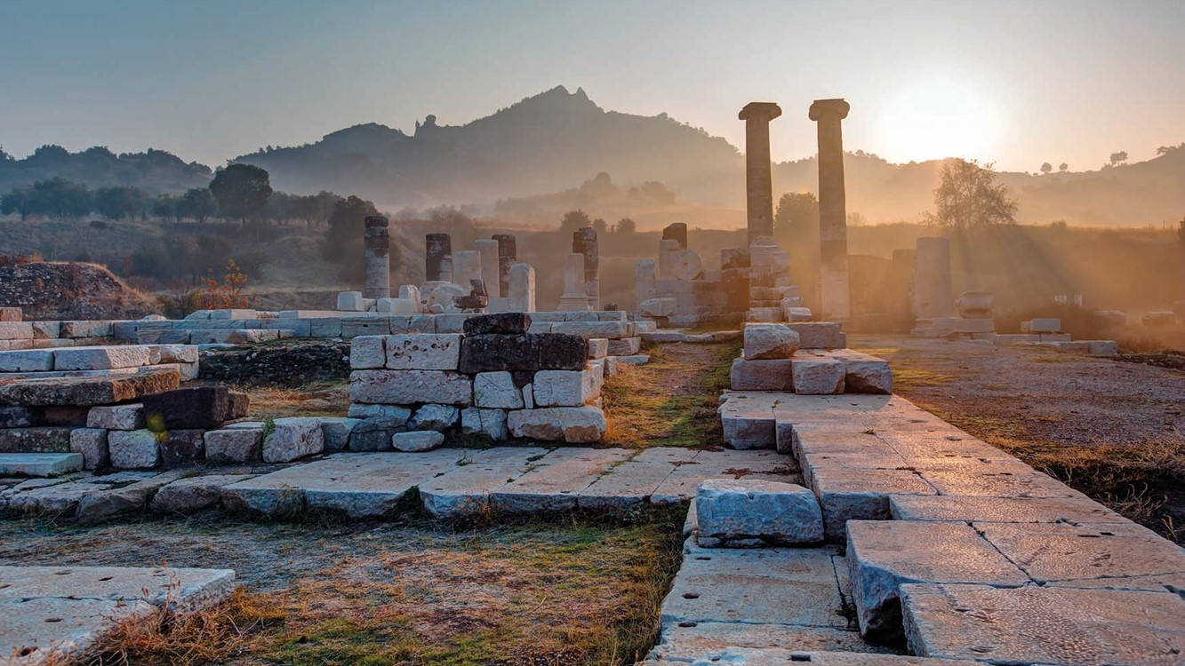
ANCIENT GREEKS – YOUNG HEROES
LESSON 4

Slide 2
The Ancient Greeks… and stories about giants
Sindbad and Odysseus
In welke goden geloofden de oude Grieken?
Giants
Quiz: which monster are you?

Slide 3
Time for a game!

Slide 4
Recap
Χαος
Ψυχη
δενδρον
φιλος
φοβος
γιγας
Notes:
Link gigas to lesson topic and introduction

Slide 5
Who knows a γιγας?

Slide 6
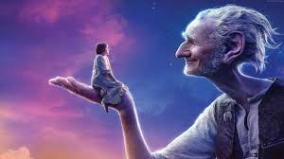
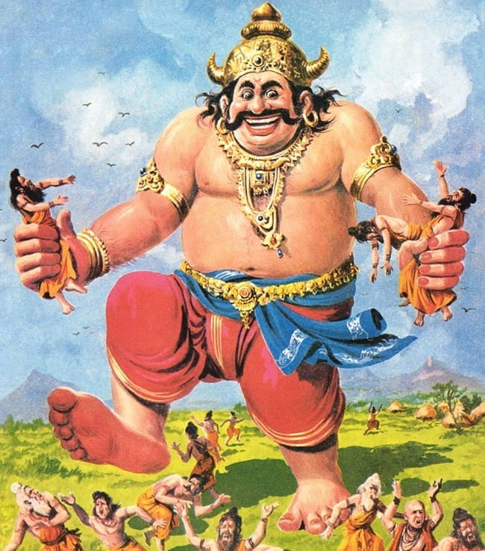
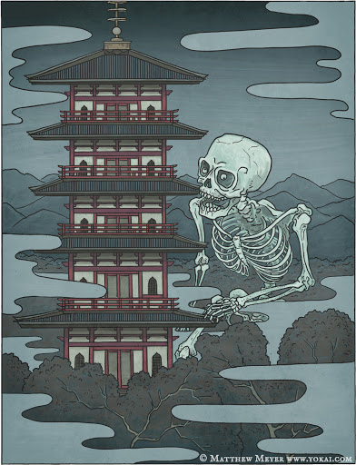
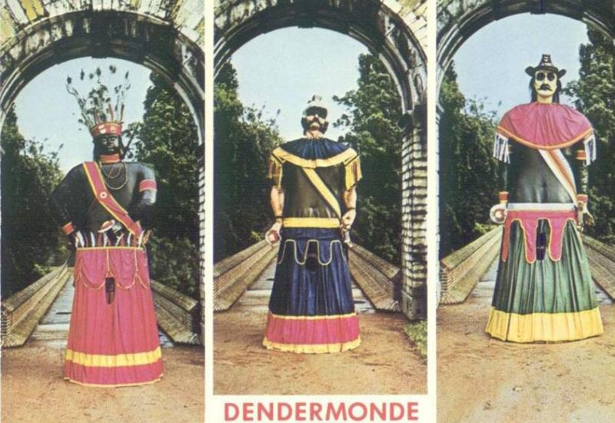
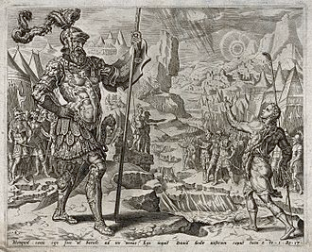
Who knows a γιγας?
Notes:
Left to right: Reuzenommegang (Giants’ Procession) in Dendermonde - Japanese giant’s skeleton: The Gashadokuro are spirits that take the form of giant skeletons and are fifteen times larger than an average person, said to be created from the amassed bones of people who died of starvation or in battle, without being buried – BFG – Goliath – top right: Kumbhakarna, Indian god

Slide 7
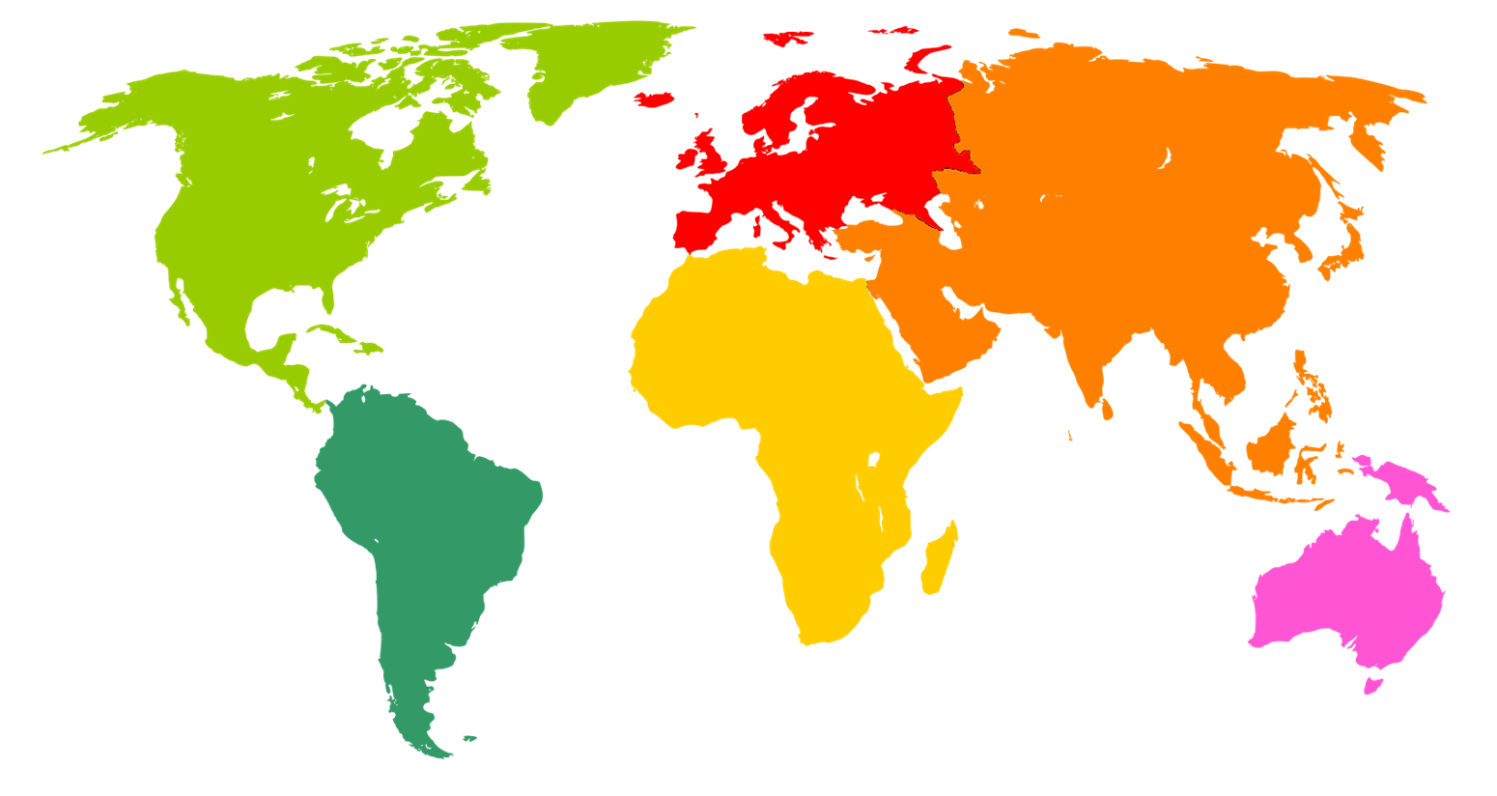

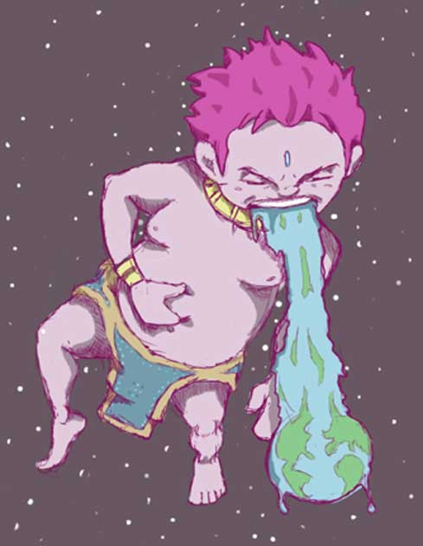
Giants in different story traditions
Notes:
Here you can indicate where different giants come from:
Madremonte in South America a giant who protects nature - Mbombo in Congo, a white giant who created the earth by surrendering - the giants in Dendermonde - Kumbhakarna, Indian god who is rather gluttonous and finally Gashadokuro, the Japanese spirit who consists of all the bones of dead people who have never been buried

Slide 8
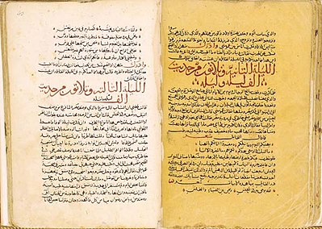
The Arabian Nights
Who knows Arabic?
Who knows fairy tales?

Slide 9
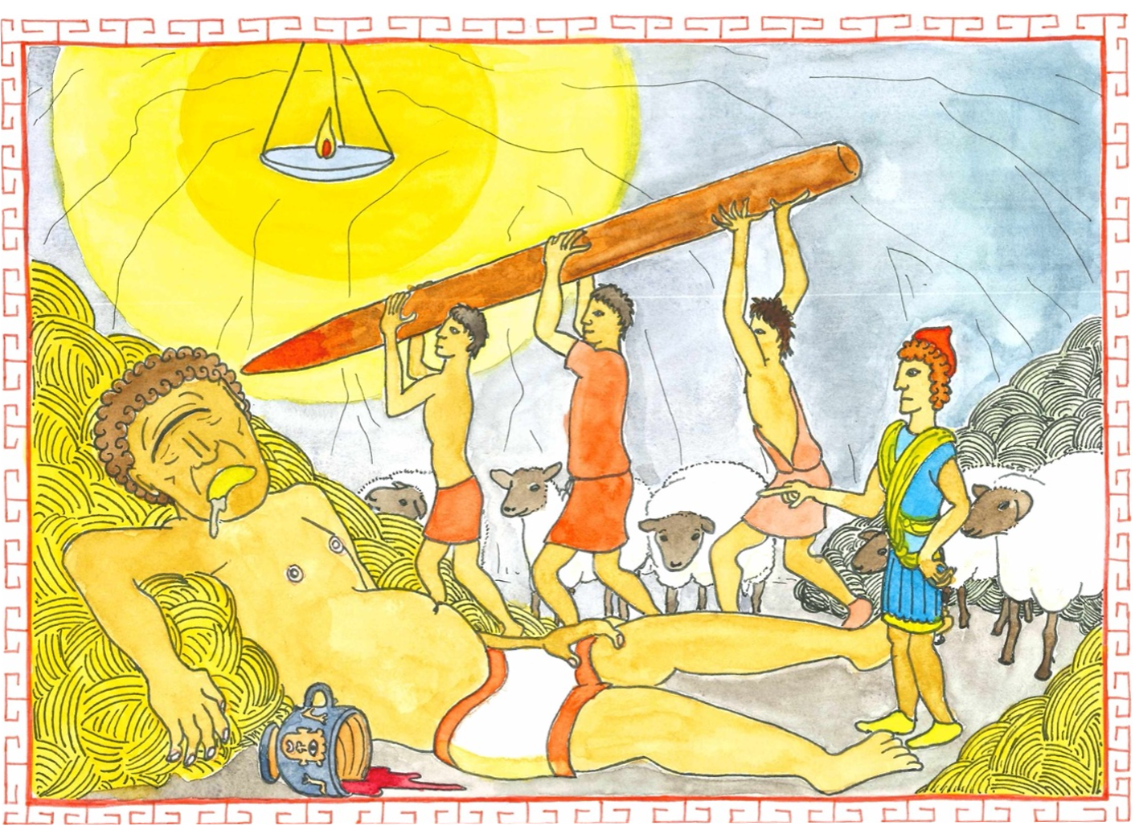
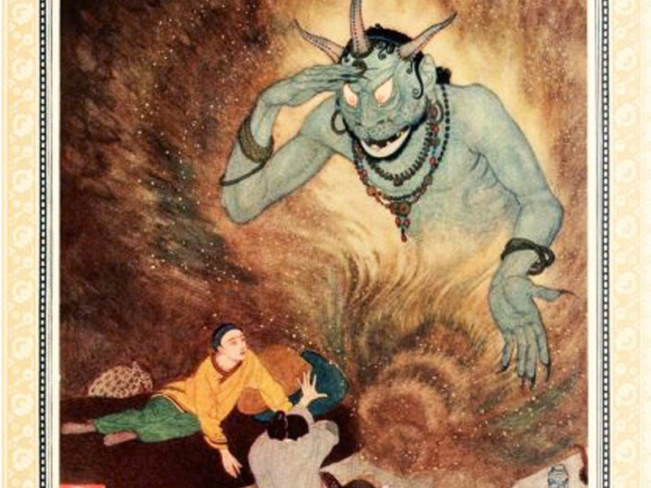
Odysseus and Sinbad
versus giants

Slide 10
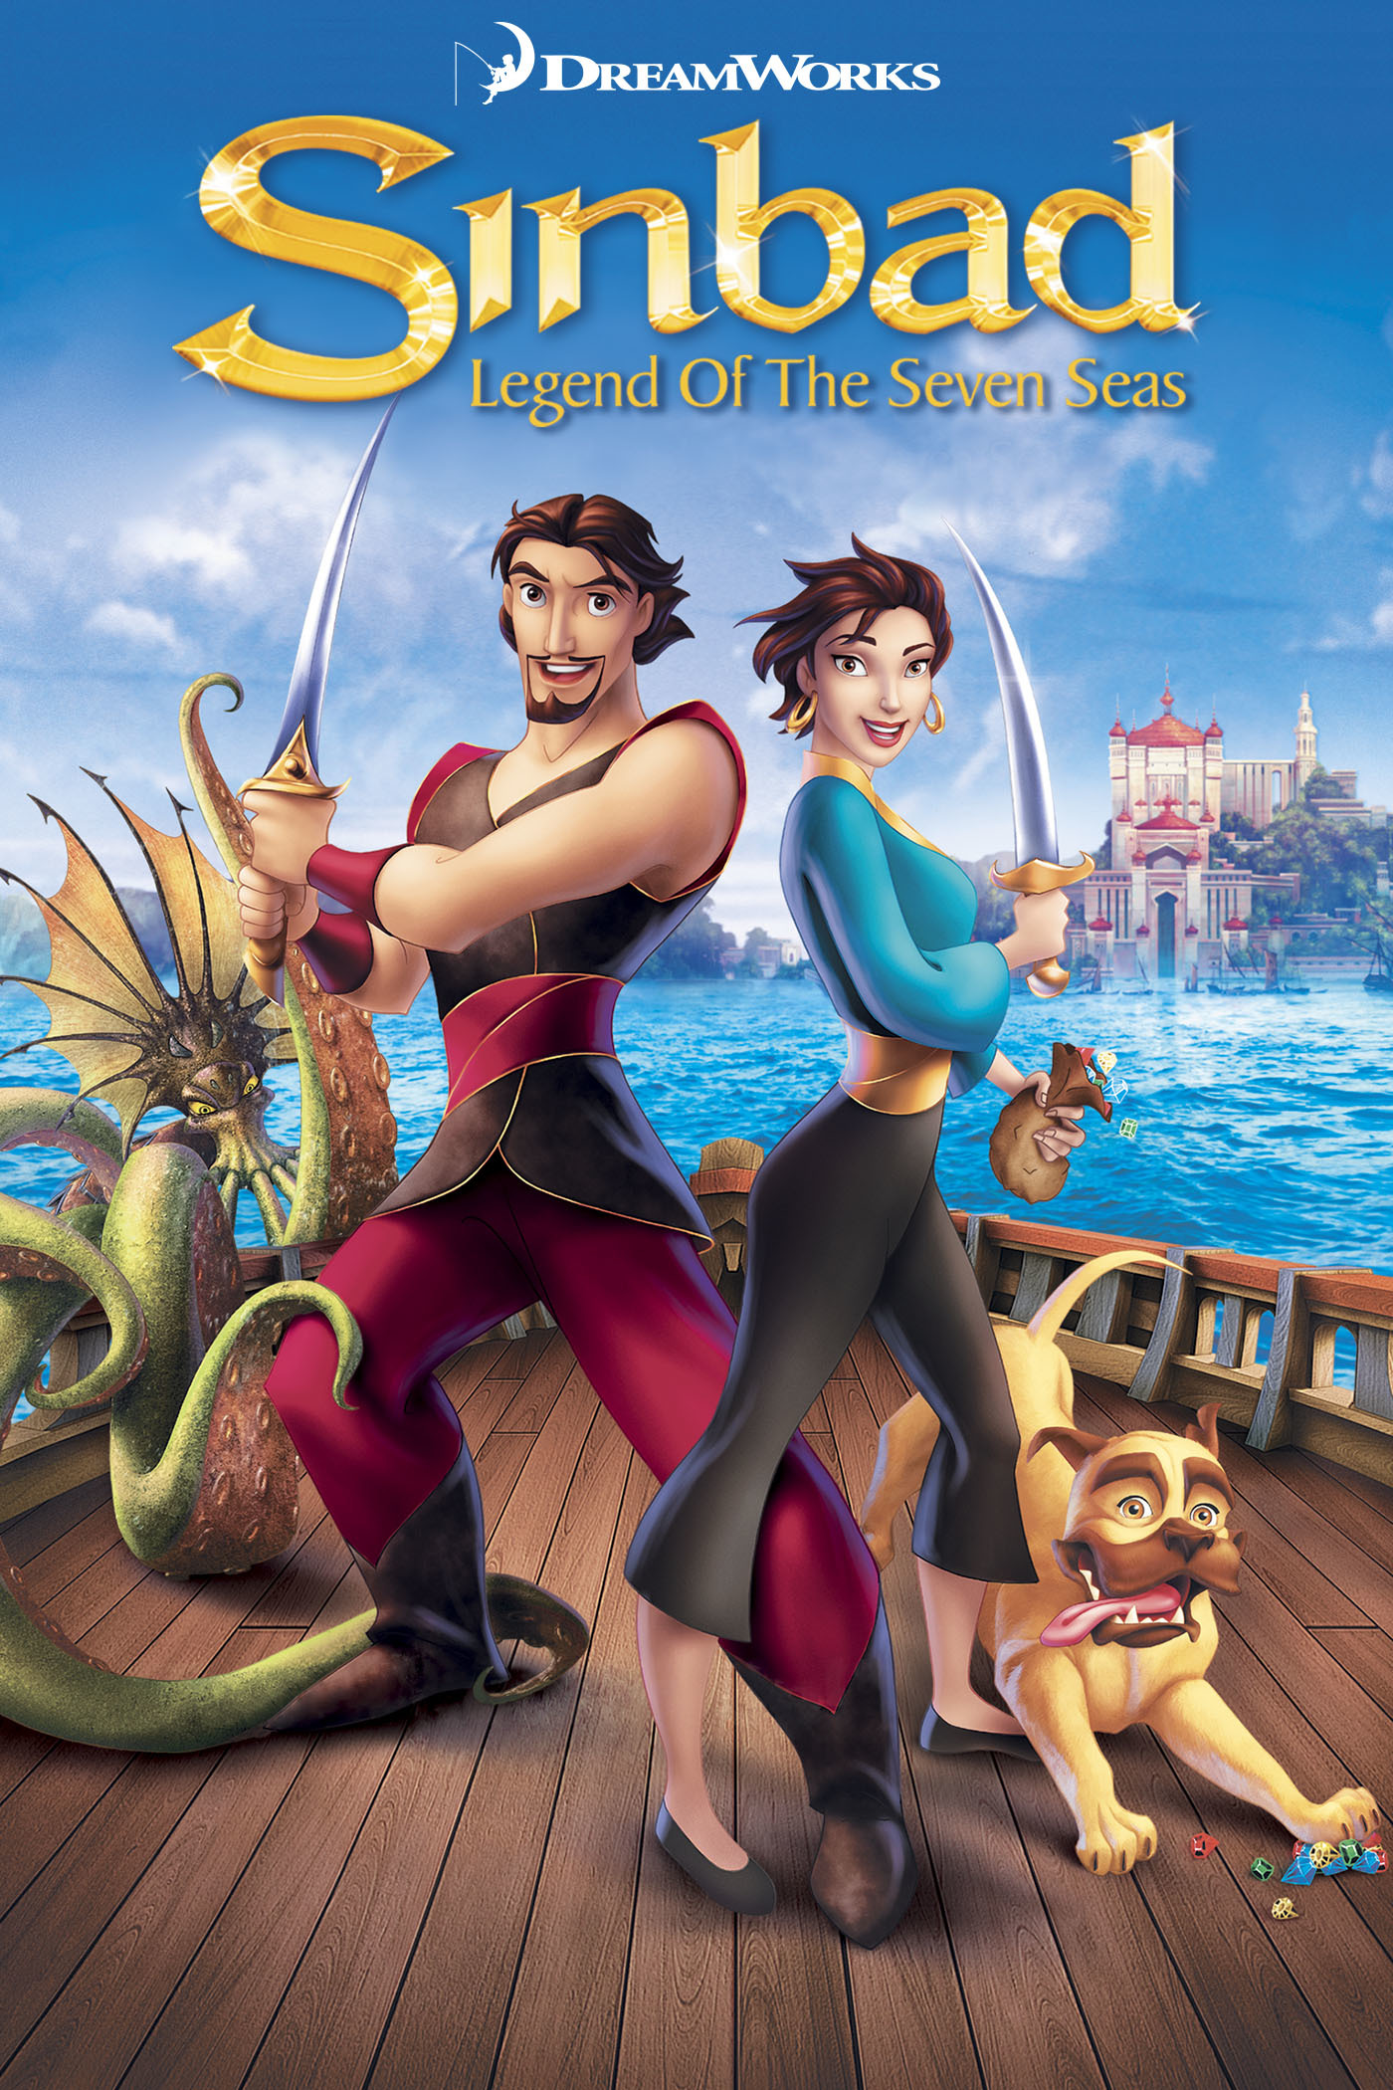
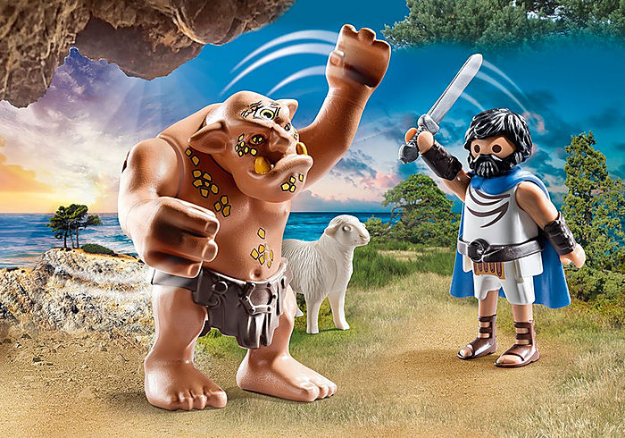
Story
Sinbad and the Giant
Odysseus and Polyphemus
Notes:
M

Slide 11
Time for a quiz!

Slide 12
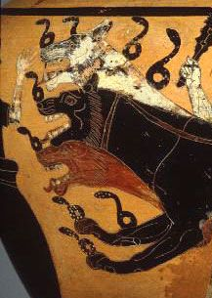
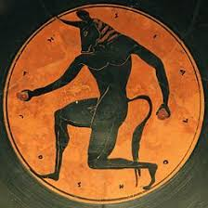
Which monster are you?
Notes:
The 3 monsters: minotaur, Kerberos and giant

Slide 13
What will you take away from this lesson?

