Slide 1
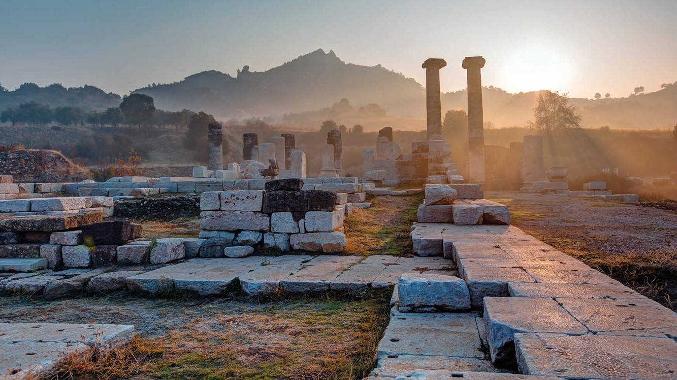
ANCIENT GREEKS – YOUNG HEROES
LESSON 3

Slide 2
Greek snakes and families...
Greek words in English
Medusa’s snakes and her family
Creative
with clay

Slide 3
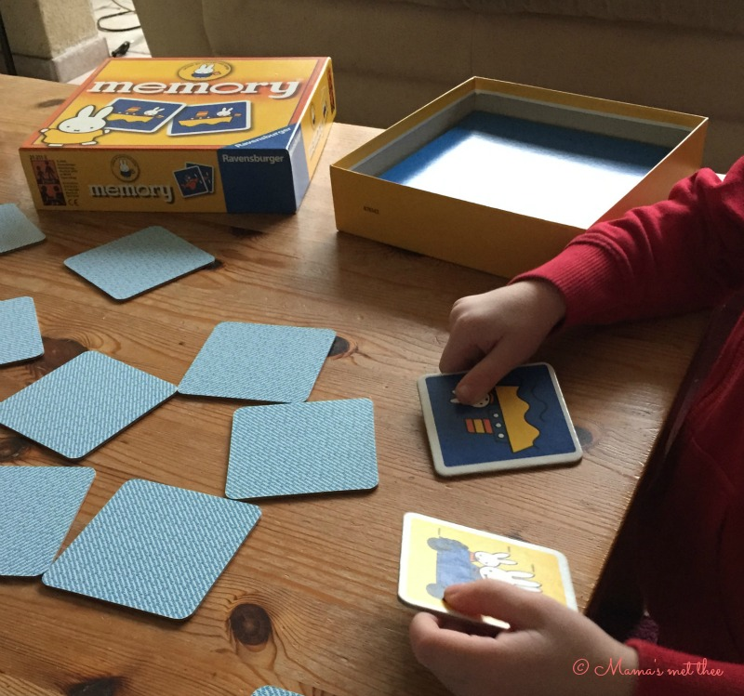
Time for a game: Greek Memory

Slide 4
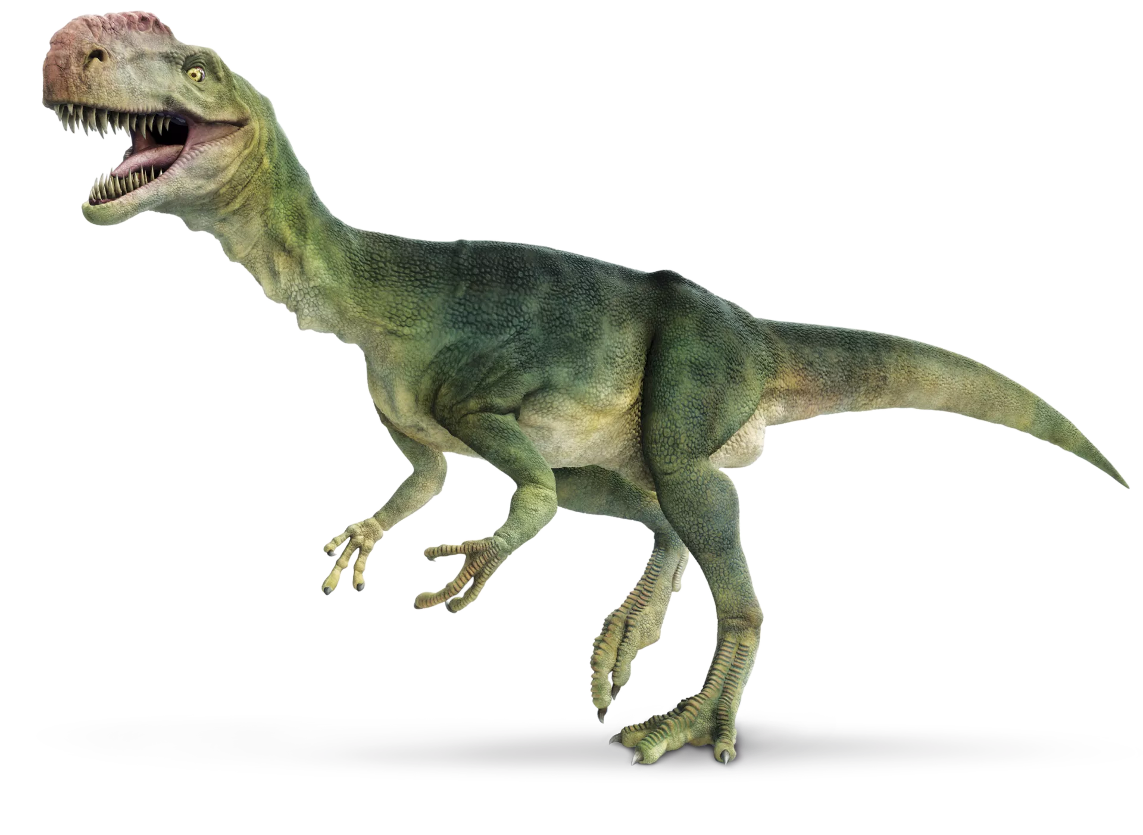

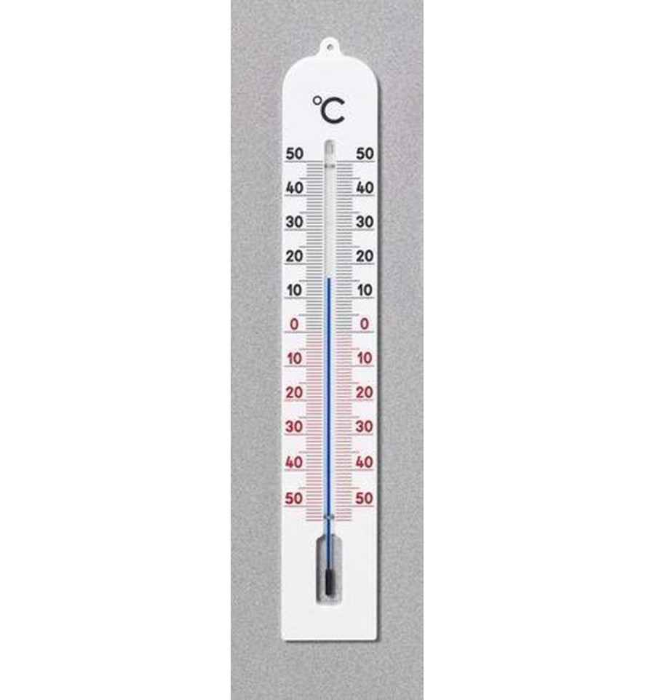
Greek words in English
Dinosaur
Geography
Thermometer
Notes:
Dinosaur < δεινός (terrible) + σαύρα (lizard)
Geography < γῆ (earth) + γραφή (writing)
Thermometer < θέρμος (hot) + μέτρον (measure)

Slide 5

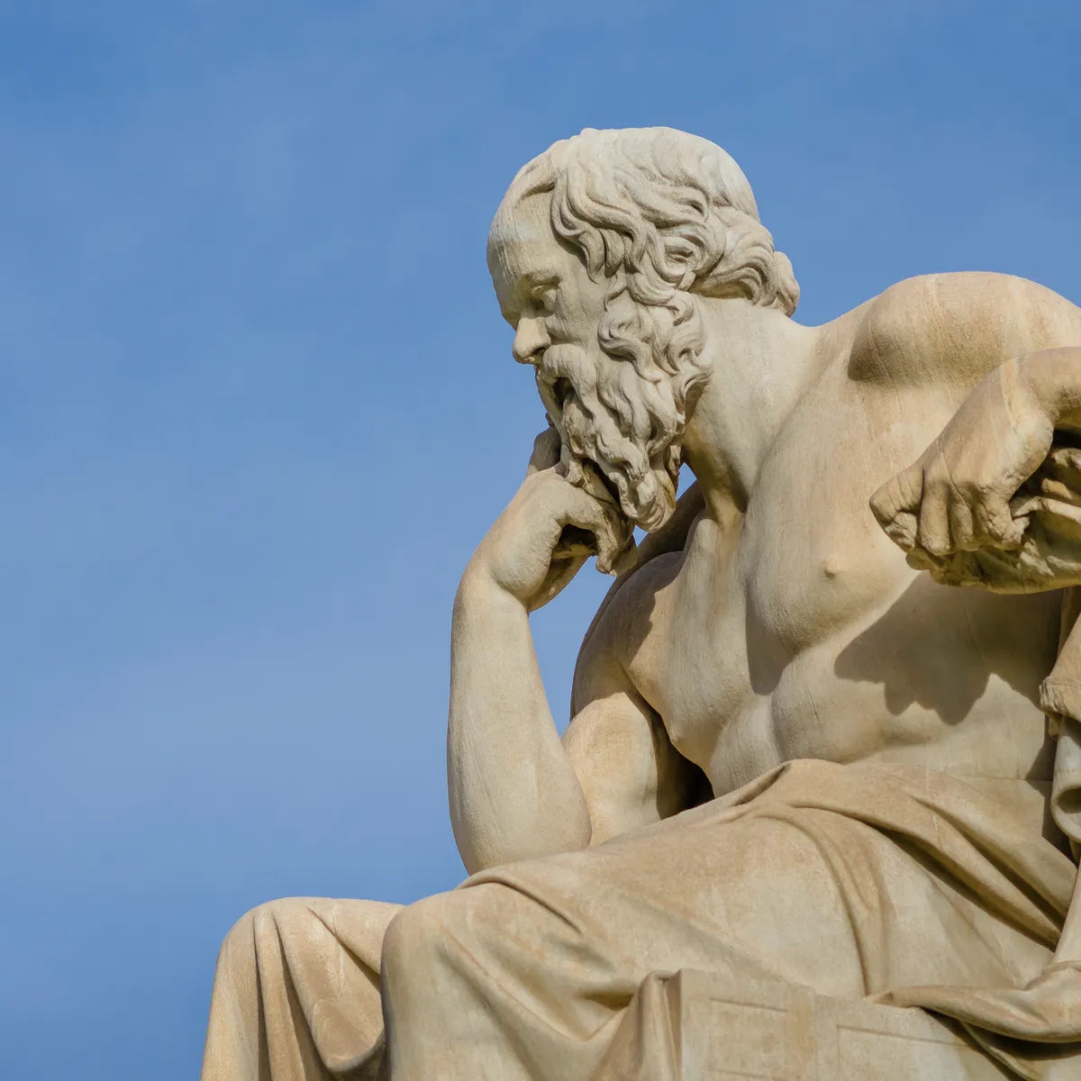
Greek words in English
Biology
Philosopher
Notes:
Biology < βιός (life) + λόγος (word)
Philosopher < φίλος (friend) + σοφός (wise)

Slide 6
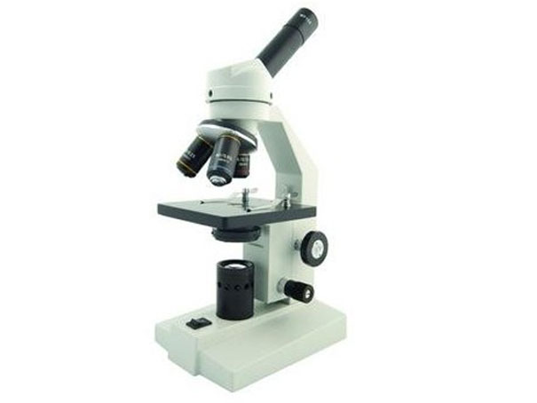

Greek words in English
Microscope
Psychology
Notes:
Microscope < μικρός (little) + σκοπος (the person who watches)
Psychology < ψυχή (soul) + λόγος (word)

Slide 7
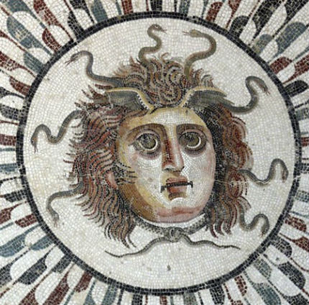
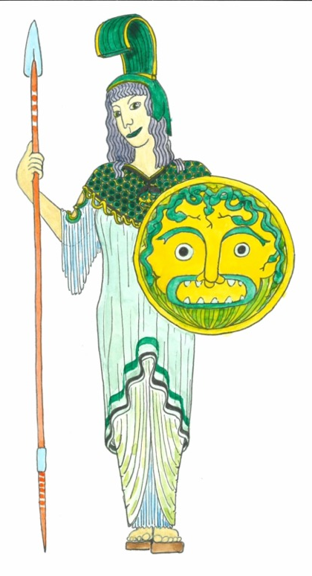
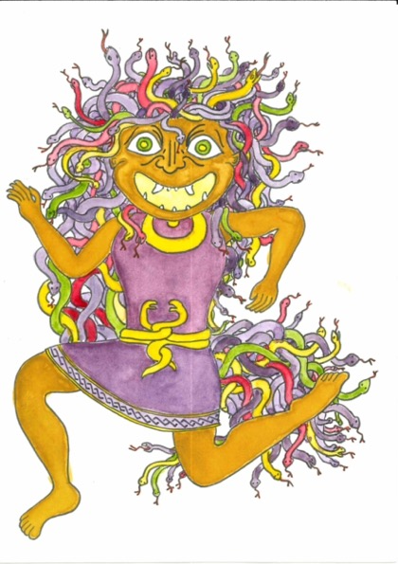
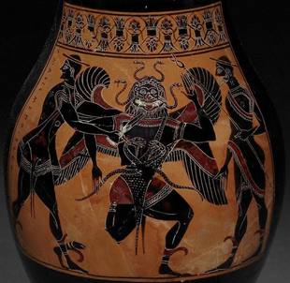
Have you met μεδουσα yet?

Slide 8
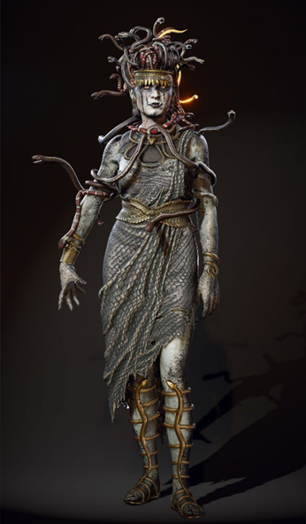
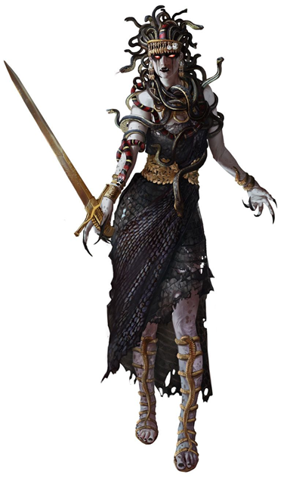
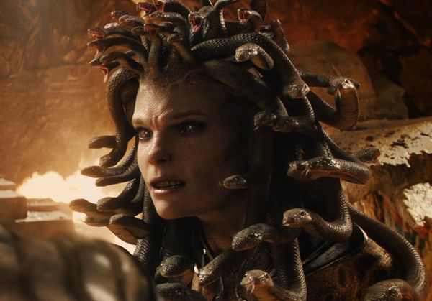
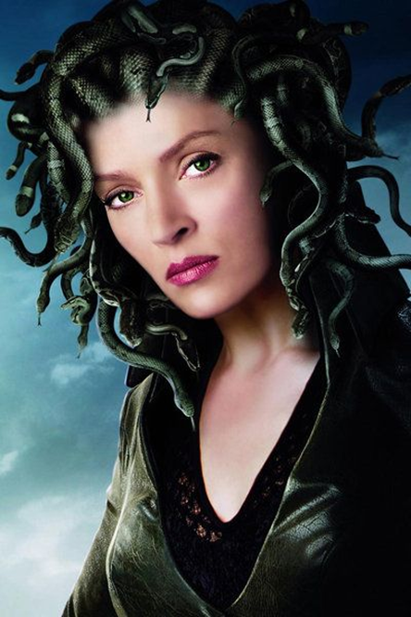
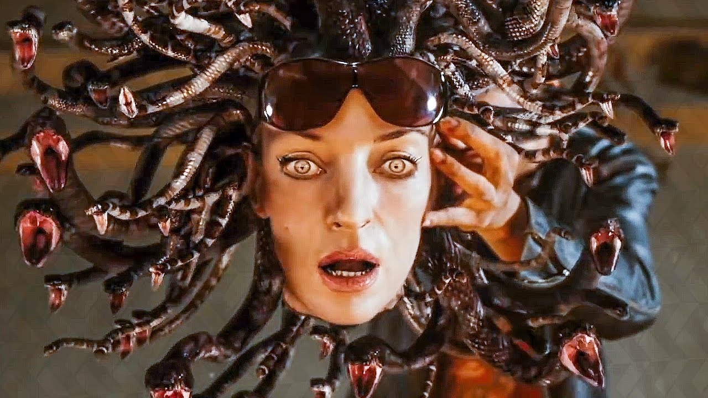
Μεδουσα here and now: films and games
Notes:
From left to right: Medusa in Assasin's Creed Odyssey (2 images on left), in Clash of the Titans (2010) (top centre), in Percy Jackson (bottom centre and right)

Slide 9
Μεδουσα’s family
γαια
μεδουσα

Slide 10
Μεδουσα’s family
ποντος
γαια
φορκυς
κητω
μεδουσα
σθενω
πηγασος

Slide 11
Families in different languages
Greek German Dutch French English
μητηρ Mutter mother
père father
zus sister
ἀδελφος brother
fille daughter
υἱος Sohn son
παιδια kinderen children

Slide 12
Solution family members
Greek German Dutch French English
μητηρ Mutter moeder mère mother
πατηρ Vater vader père father
ἀδελφη Schwester zus sœur sister
ἀδελφος Bruder broer frère brother
θυγατηρ Tochter dochter fille daughter
υἱος Sohn zoon fils son
παιδια Kinder kinderen enfants children

Slide 13
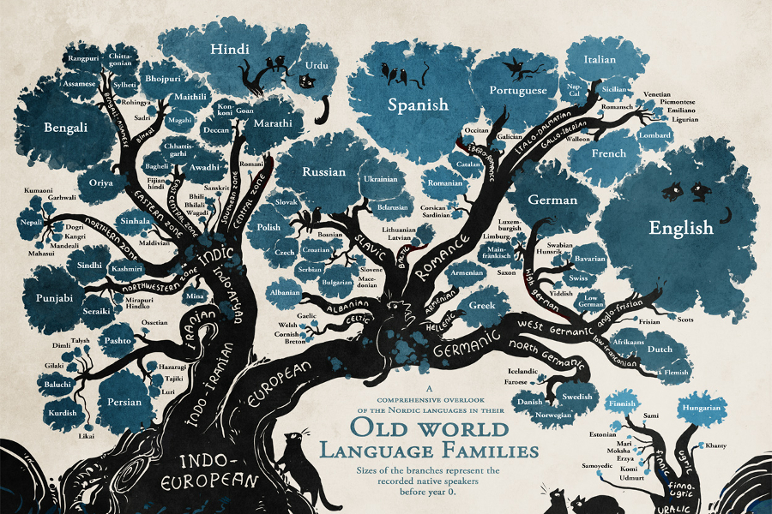
From The Guardian website: https://www.theguardian.com/education/gallery/2015/jan/23/a-language-family-tree-in-pictures

Slide 14
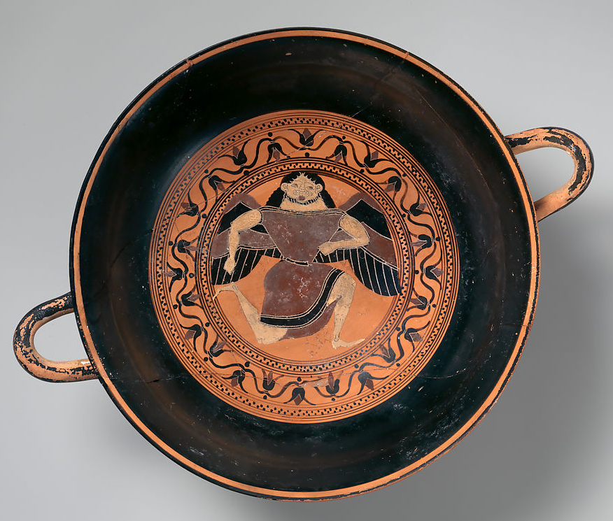
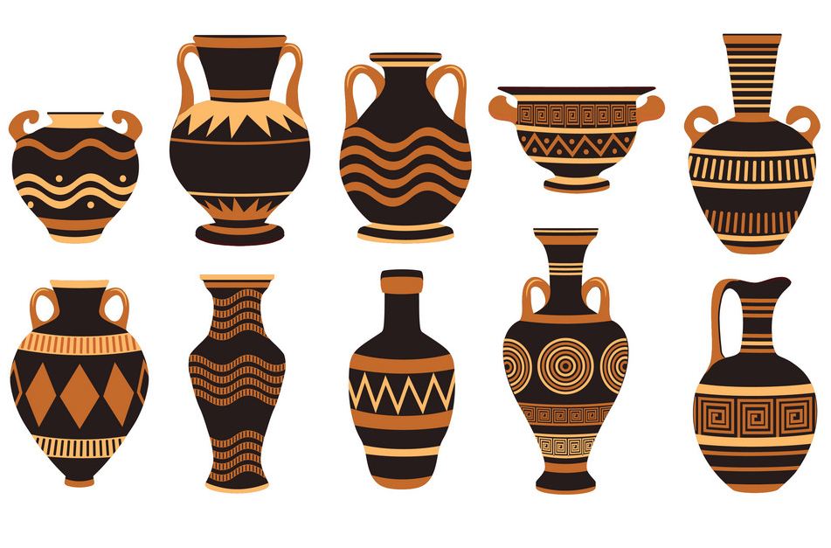
Greek ceramics

Slide 15
Make your own pot

Slide 16
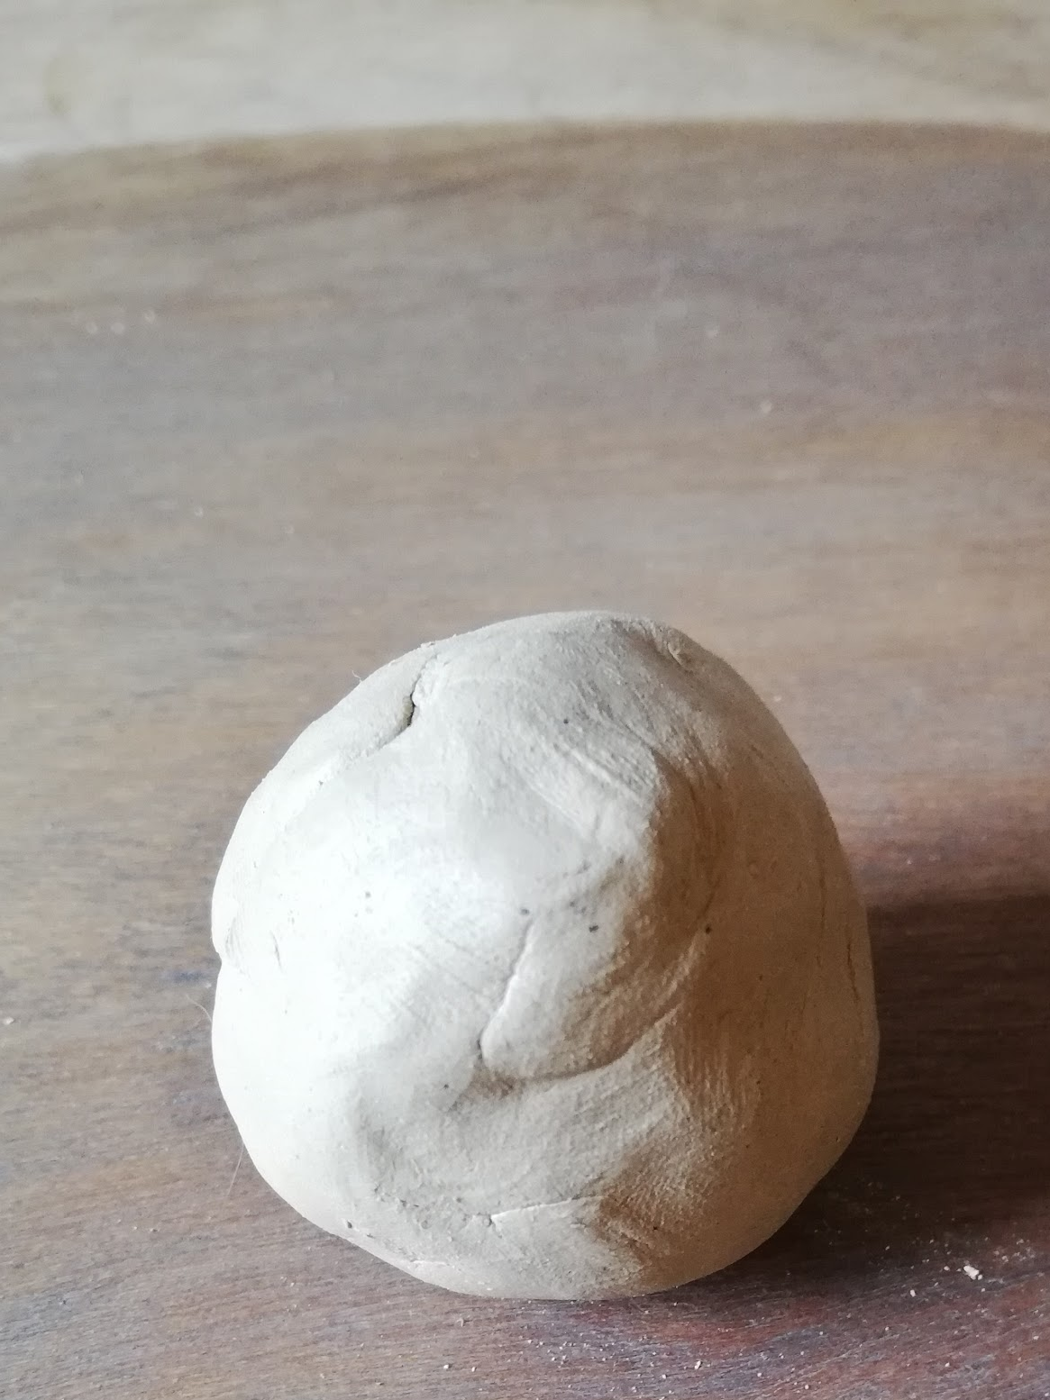
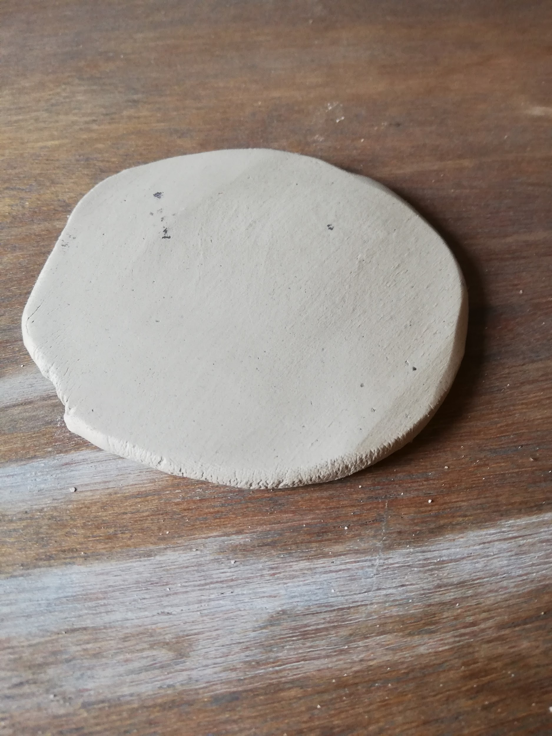
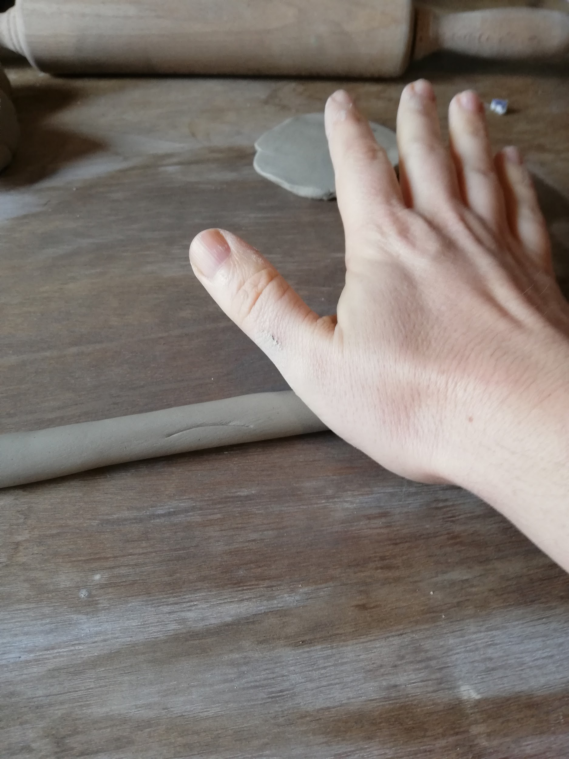
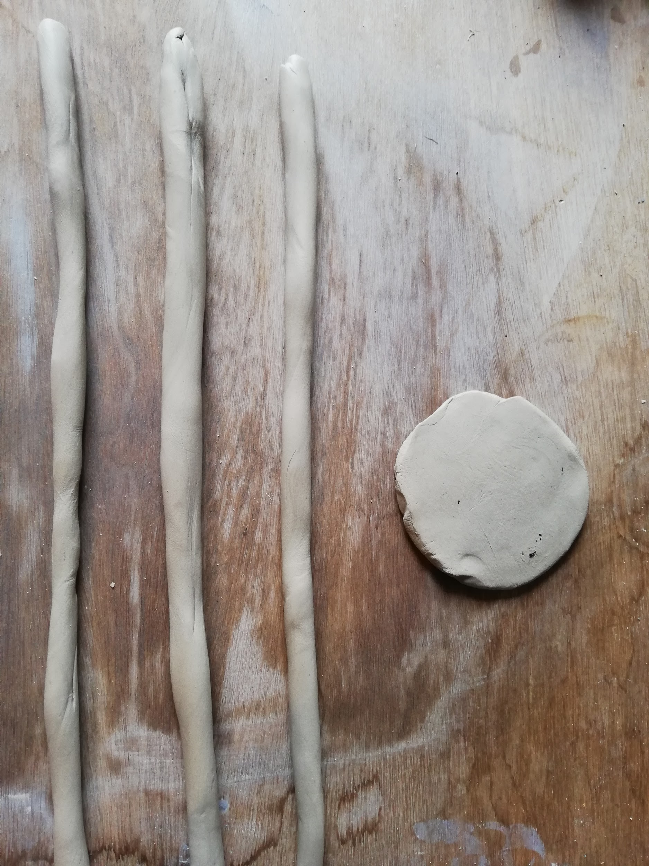
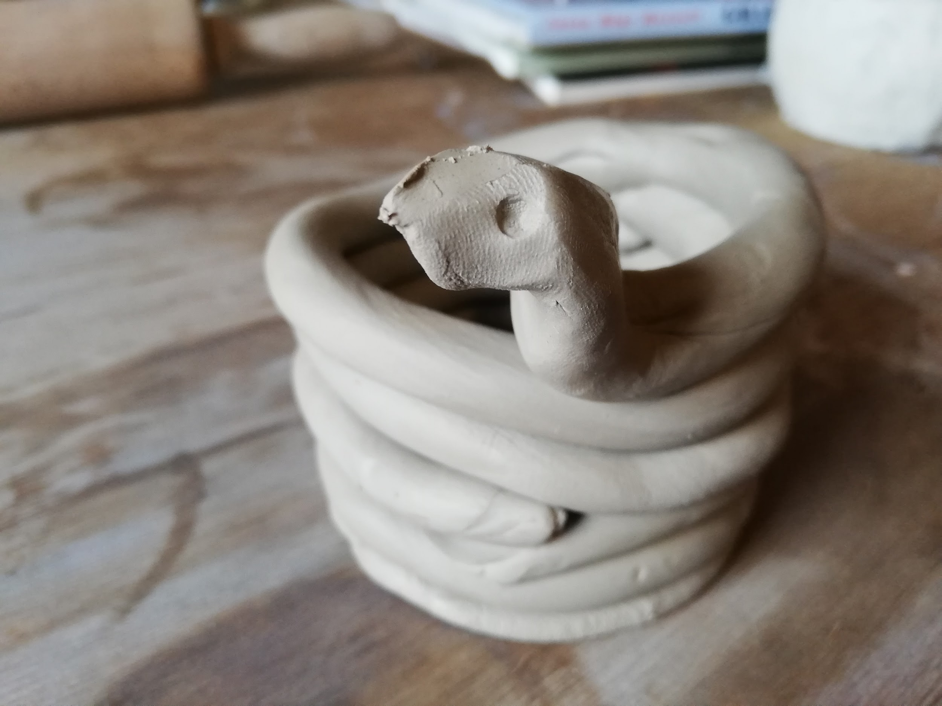
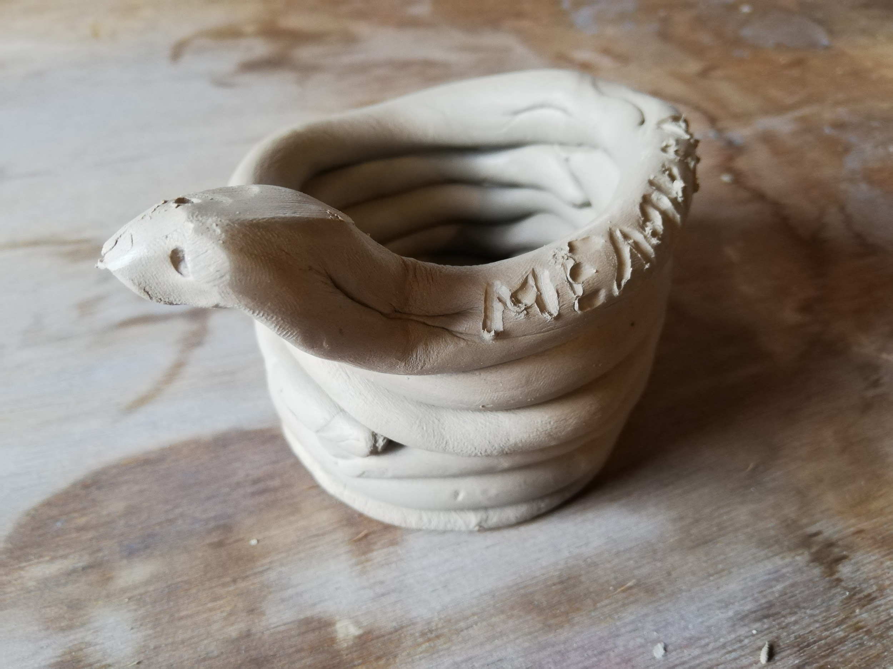
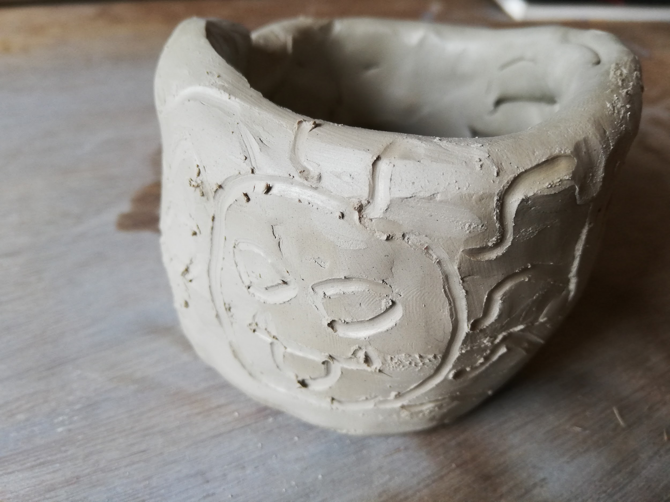
Clay pen holder

Slide 17
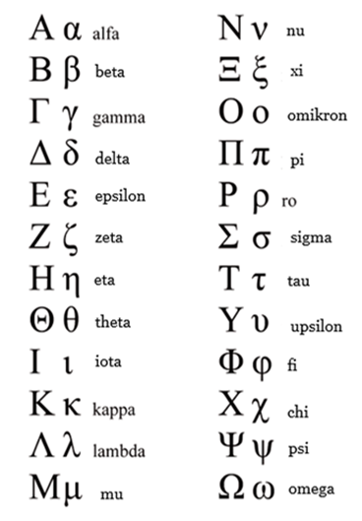
My name in Ancient Greek
Your name+ η, ος or ον
  Παυλ-ος
  Ἑλεν-η
  Παιδι-ον

Slide 18
What will you take away from this lesson?
Theatre comes from the Greek word …
Μεδουσα is a woman with … instead of hair.
Is my πατηρ my sister or my father?

Slide 19
What will you take away from this lesson?
Theatre comes from the Greek word …
Θεατρον
Μεδουσα is a woman with … instead of hair.
snakes
Is my πατηρ my sister or my father?
father

