Slide 1
ANCIENT GREEKS – YOUNG HEROES LESSON 5

Slide 2
THE ANCIENT GREEKS …
Orders
in Ancient Greek
Board game
Stories from other cultures

Slide 3
Review
Hangman or Bingo

Slide 4
Hangman
δενδρον
Μινωταυρος
γιγας
βιος
ψυχη
Ὀδυσσευς
θερμος
Μεδουσα
φιλος
Εὐρωπη
Κερβερος
παιδιον

Slide 5
Bingo

Slide 6
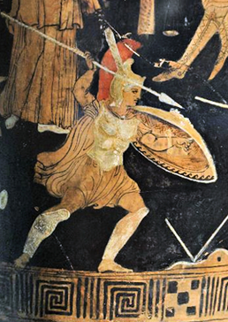
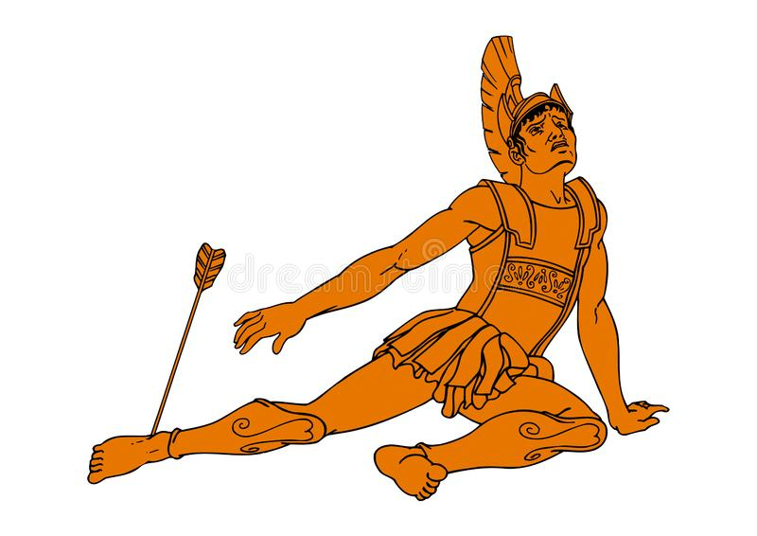
Commands
βαλλε! πιπτε!

Slide 7
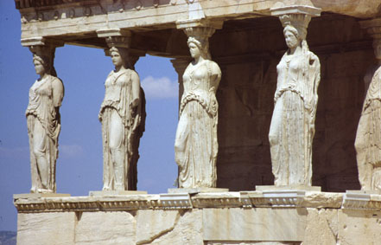
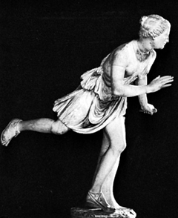
Commands
παυε! τρεχε!
Notes:
A fact: on the left Caryatids (women used as pillars), on the right the fast Atalanta

Slide 8
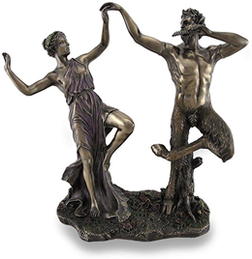
Commands
χορευε!

Slide 9
Now it’s your turn!
Commands
Notes:
You can project this slide when you are doing the TPR inside. You can point at the right image if they have forgotten the meaning.

Slide 10
Commands
For 1 person | For more persons
βαλλε | βαλλετε
παυε | παυετε
πιπτε | πιπτετε
τρεχε | τρεχετε
χορευε | χορευετε
Notes:
You can project this slide when they are making the exercises on the handout.

Slide 11
It’s time for a game!
Choose your hero and put your piece on the starting point of your hero!
Red: Gilgamesh Blue: Odysseus Green: Sindbad
Goal: Returning home (yellow square)
How do you do this?
Roll the dice.
Move your piece up, down or to the side.
Pass by all the squares of your colour: draw a card from your deck and answer the question on it.
Watch out for all the rocks! You are not allowed to use these squares.
A hurricane brings you immediately to the other square with a hurricane on it.
Chance: draw a purple card from the deck.
Did you stop on a beige or a light blue square? Answer a question from the handout.

Slide 12
Heroes for the Greeks and their neighbours
What a trip!
What are the similarities?
What are the differences?

Slide 13
Questionnaire
&
Diploma ceremony

